Slide 1


Organisational Behaviour
Topic name-Introduction to OB
Submitted by
Prasant Barla
Asst. professor in Management
Veer Surendra Sai University Technology, Burla

Slide 2
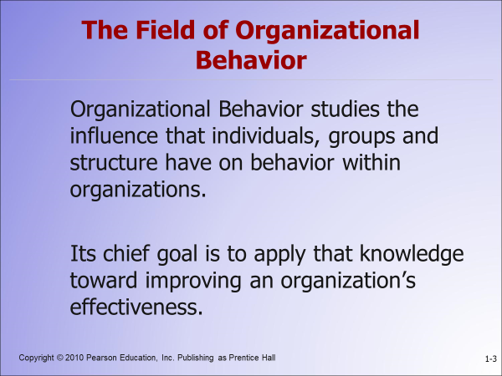
Introduction to OB

Slide 3

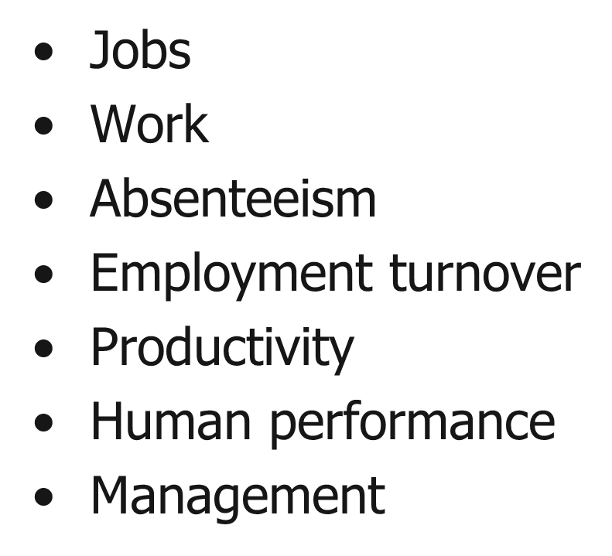
Focal Points of OB

Slide 4
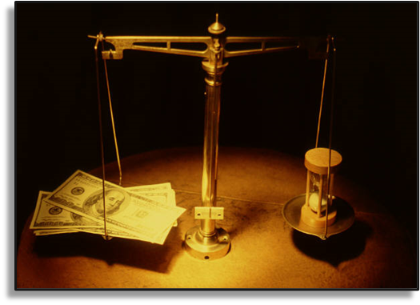
Evidence-Based Management
Complements systematic study.
Bases decisions on the best available scientific evidence.
Forces managers to become more scientific in their thinking

Slide 5

Contributing Disciplines to the OB Field
Micro:
The Individual
Psychology
Social Psychology
Macro:
Groups &
Organizations
Sociology
Anthropology

Slide 6
Challenges and opportunities for OB
There are many challenges and opportunities for managers to use Organizational Behavior concepts to enhance the overall effectiveness of individuals, groups and organization. The following are some of the critical issues confronting managers for which the knowledge of Organizational Behavior offers worthy solutions based on behavioral science and other interdisciplinary fields.
i)Improving People Skills
ii) Improving Quality and Productivity
iii) Managing Workforce Diversity
iv) Responding to Globalization
v) Empowering People
vi) Coping with Temporariness
vii) Stimulating Innovation and Change
viii) Improving Ethical Behavior

Slide 7
Improving People Skills:
Technological changes, structural changes, environmental changes are accelerated at a
faster rate in business field. Unless employees and executives are equipped to possess the
required skills to adapt those changes, the achievement of the targeted goals cannot be achieved
in time. There two different categories of skills – managerial skills and technical skills. Some of
the managerial skills include listening skills, motivating skills, planning and organizing skills,
leading skills, problem solving skill, decision making skills etc. These skills can be enhanced by
organizing a series of training and development programs, career development programs,
induction and socialization etc.
Managerial implications

Slide 8
Improving Quality and Productivity:
Quality is the extent to which the customers or users believe the product or service
surpasses their needs and expectations. For example, a customer who purchases an automobile
has certain expectation, one of which is that the automobile engine will start when it is turned on.
If the engine fails to start, the customer’s expectations will not have been met and the customer
will perceive the quality of the car as poor. Deming defined quality as a predictable degree of
uniformity and dependability, at low cost and suited to the market.
Managerial implications

Slide 9
Managing Workforce Diversity:
This refers to employing different categories of employees who are heterogeneous in
terms of gender, race, ethnicity, relation, community, physically disadvantaged, homosexuals,
elderly people etc. The primary reason to employ heterogeneous category of employees is to tap
the talents and potentialities, harnessing the innovativeness, obtaining synergetic effect among
the divorce workforce. In general, employees wanted to retain their individual and cultural
identity, values and life styles even though they are working in the same organization with
common rules and regulations. The major challenge for organizations is to become more
accommodating to diverse groups of people by addressing their different life styles, family needs
and work styles.
Managerial implications

Slide 10
Responding to Globalization:
Today’s business is mostly market driven; wherever the demands exist irrespective of
distance, locations, climatic conditions, the business operations are expanded to gain their market
share and to remain in the top rank etc. Business operations are no longer restricted to a
particular locality or region. Company’s products or services are spreading across the nations
using mass communication, internet, faster transportation etc. An Australian wine producer now
sells more wine through the Internet than through outlets across the country. More than 95% of
Nokia hand phones are being sold outside of their home country Finland. Japanese cars are being
sold in different parts of globe. Sri Lankan tea is exported to many cities across the globe.
Executives of Multinational Corporation are very mobile and move from one subsidiary to
another more frequently.
Managerial implications

Slide 11
Empowering People:
The main issue is delegating more power and responsibility to the lower level cadre of
employees and assigning more freedom to make choices about their schedules, operations,
procedures and the method of solving their work-related problems. Encouraging the employees
to participate in work related decision will sizably enhance their commitment at work.
Empowerment is defined as putting employees in charge of what they do by eliciting some sort
of ownership in them. Managers are doing considerably further by allowing employees full
control of their work. An increasing number of organizations are using self-managed teams,
where workers operate largely without boss. Due to the implementation of empowerment
concepts across all the levels, the relationship between managers and the employees is reshaped.
Managers will act as coaches, advisors, sponsors, facilitators and help their subordinates to do
their task with minimal guidance
Managerial implications

Slide 12
Coping with ‘Temporariness:
In recent times, the Product life cycles are slimming, the methods of operations are
improving, and fashions are changing very fast. In those days, the managers needed to introduce
major change programs once or twice a decade. Today, change is an ongoing activity for most
managers. The concept of continuous improvement implies constant change. In yester years,
there used to be a long period of stability and occasionally interrupted by short period of change,
but at present the change process is an ongoing activity due to competitiveness in developing
new products and services with better features. Everyone in the organization faces today is one
of permanent temporariness. The actual jobs that workers perform are in a permanent state of
flux. So, workers need to continually update their knowledge and skills to perform new job
requirements.
Managerial implications

Slide 13
Stimulating Innovation and Change:
Today’s successful organizations must foster innovation and be proficient in the art of
change; otherwise they will become candidates for extinction in due course of time and vanished
from their field of business. Victory will go to those organizations that maintain flexibility,
continually improve their quality, and beat the competition to the market place with a constant
stream of innovative products and services. For example, Compaq succeeded by creating more
powerful personal computers for the same or less money than IBNM or Apple, and by putting
their products to market quicker than the bigger competitors. Amazon.com is putting a lot of
independent bookstores out of business as it proves you can successfully sell books from an
Internet website.
Managerial implications

Slide 14
Improving Ethical behaviour:
The complexity in business operations is forcing the workforce to face ethical dilemmas,
where they are required to define right and wrong conduct in order to complete their assigned activities. For example, Should the employees of chemical company blow the whistle if they uncover the discharging its untreated effluents into the river are polluting its water resources? Do managers give an inflated performance evaluation to an employee they like, knowing that such an evaluation could save that employee’s job?
Managerial implications

Slide 15
Thank u….

